Slide 1
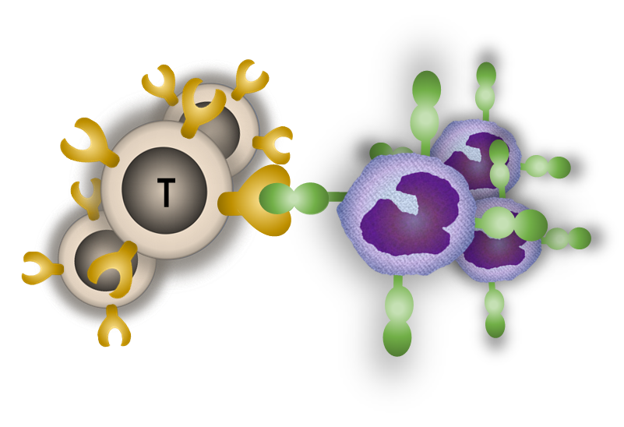
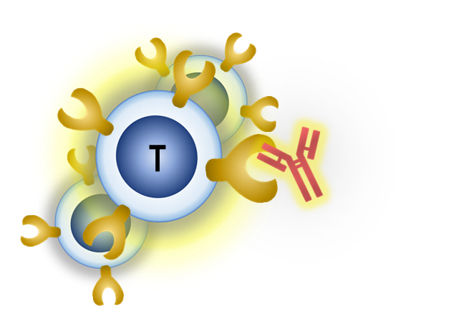
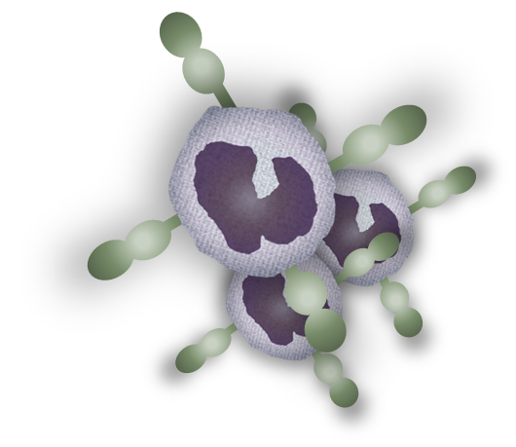
PGE₂
Anti-PD-1/PD-L1 antibodies
PGE₂
Inhibitory signal
PD-1
PD-L1
Elimination
Exhausted T cells
Infected cells
Reactivated T cells
T cell exhaustion
in chronic infection
COX2 inhibitor
T cell reactivation
by blocking antibodies and COX2 inhibitor
Supplemental Figure 1. The PD-1/PD-L1 pathway as a mechanism of immune evasion during chronic infection. PD-1, an inhibitory receptor expressed on T cells (exhausted T cells), interacts with its ligand, PD-L1, which is expressed on infected cells. The PD-1/PD-L1 axis suppresses effector functions of T cells. PGE₂ is one of the lipid mediators which is synthesized from arachidonic acid by COX and produced from several cells. PGE₂ induces the suppression of several immune cells via EP2 or EP4. PGE₂ is one of the inducers for PD-L1 expression in cancers and chronic infections. Antibody blockade of the PD-1/PD-L1 pathway and PGE₂ inhibitor restore the effector functions, resulting in the clearance of pathogens.

